Slide 1

Lesson 4: Solving SEO Problems
Kubilay Cagatay
WEB 225

Slide 2

What Is a Search Engine Spider?
A search engine spider, also known as a web crawler, is an Internet bot that crawls websites and stores information for the search engine to index.

Slide 3
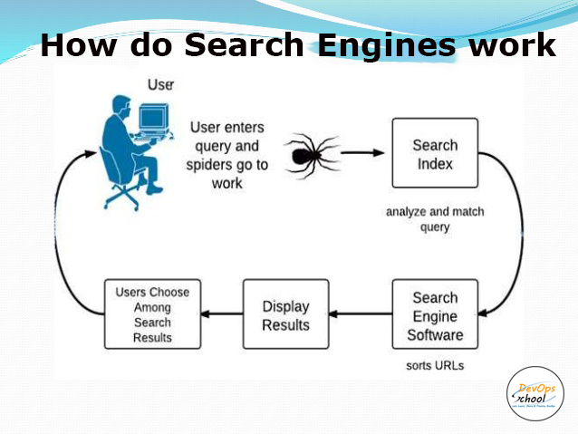
How do search engine spiders work?
Spiders, such as Googlebot, visit web pages in search of new data to add to the index. This is critical because Google’s business model is reliant on providing high-quality, relevant, and up-to-date search results.

Slide 4

The spiders are pretty smart, too. They recognize hyperlinks, which they can either follow right away, or take a note of for later crawling. Either way, internal links between pages on the same site function similarly to stepping stones, in that they pave the way for spiders to crawl and store new information.

Slide 5
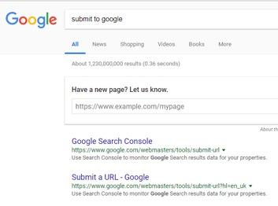
Why should I care about search engine spiders?
Search engine optimization (SEO) is all about boosting your visibility in the organic search results. You’re aiming to attain Domain Authority and get your site on page one for as many keywords as possible.
If you’re anxious to get your new stuff indexed and in the search results as soon as possible, you can directly submit the new URL to Google and tell the spider to crawl it. Once you hit submit, it shouldn’t be more than a few minutes.

Slide 6
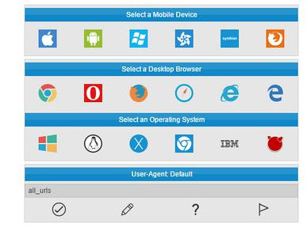
Change the Browser User Agent
A web browsers user agent is how a website knows what type of computer, operating system, and browsing app you are using. Some sites serve different themes, CSS, content, or even different sites to different browsers and OS’s, and many developers often need to change their own user agent to be able to test these abilities and build these alternate sites.

Slide 7
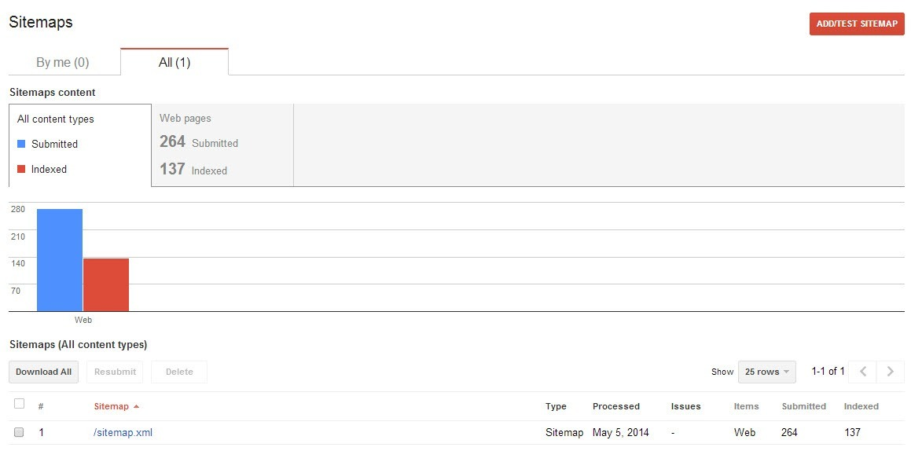
What Does “Indexed Pages” Mean?
Indexed pages have been found by search crawlers (like the spiders for Google) and deemed to have enough quality for relevant search phrases. Indexed pages will show up in search results and can drive organic traffic to your site.
In the example, you can see that 137 pages from this company’s website have been indexed by Google

Slide 8
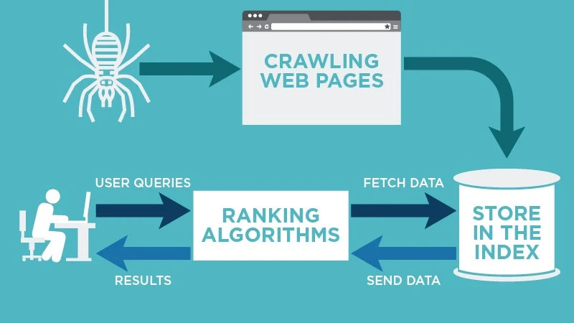
What Does “Non-Indexed pages” Mean?
Google doesn’t guarantee that it will crawl (or thus index) every URL of your website. If your website is new or you’ve recently added a lot of new pages to your site, those may not yet be indexed.
With the millions of domains out there, it takes Google a while to crawl through and index each of them to best benefit their search users.
If you’ve recently added or updated your sitemap, give it time before new pages are indexed.

Slide 9

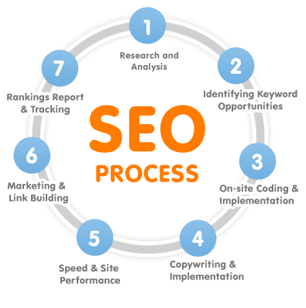
Common SEO Penalties
Manipulative linking is accountable to search engine teams’ penalties since it forces unnecessary traffic. You may get visitors, but these are visitors who are not interested in your brand. Some of the types of links to avoid are article marketing links, websites with cleansing domains, blogs with single posts, over-optimized anchor text links, and low-quality press releases.
Cloaking is a process that involves the submission of 2 different batches of reports; the reports passed to search engine teams vary from the reports that are viewable to your website visitors. However, while it is sometimes considered acceptable (i.e., It can raise traffic.), cloaking methods can lead to SEO-related penalties. To be safe, it is therefore recommended to eliminate the practices by divulging information openly.

Slide 10

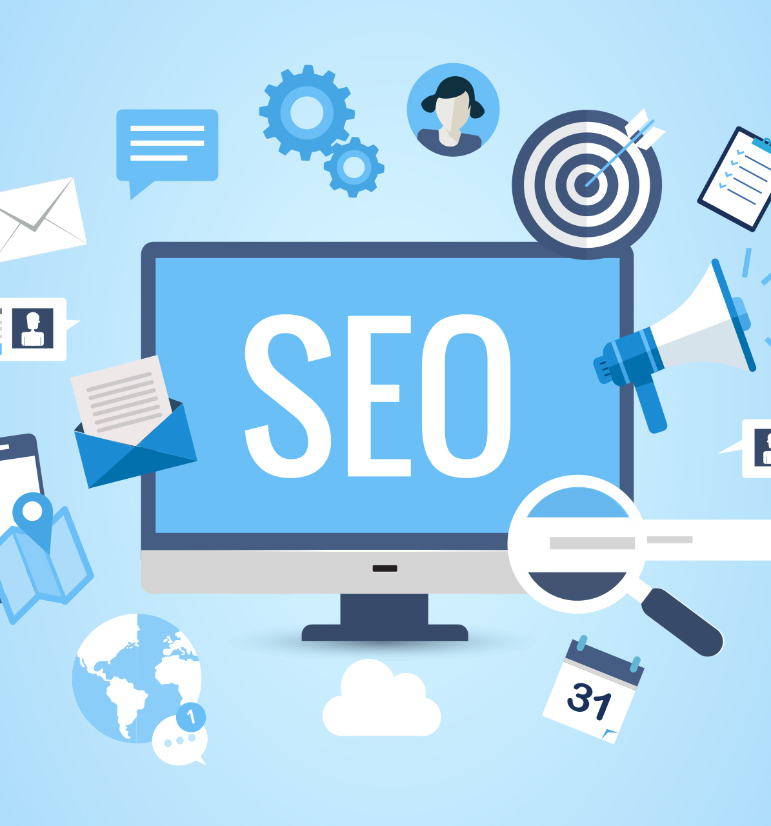
Off-site and on-site spam
Cloaking is a process that involves the submission of 2 different batches of reports; the reports passed to search engine teams vary from the reports that are viewable to your website visitors. However, while it is sometimes considered acceptable, cloaking methods can lead to SEO-related penalties.
To be safe, it is therefore recommended to eliminate the practices by divulging information openly.
Keyword stuffing
Since enhancing educational value is the primary concern, keyword stuffing can get your website banned. Using the right terms can win you potential visitors, but only through proper usage can visitors find enough reasons to remain on your site and explore further.
While there are clever ways to use keywords and key phrases, try not to go overboard. Always make sure that quality is delivered.

Slide 11

Thank you!

